Slide 1
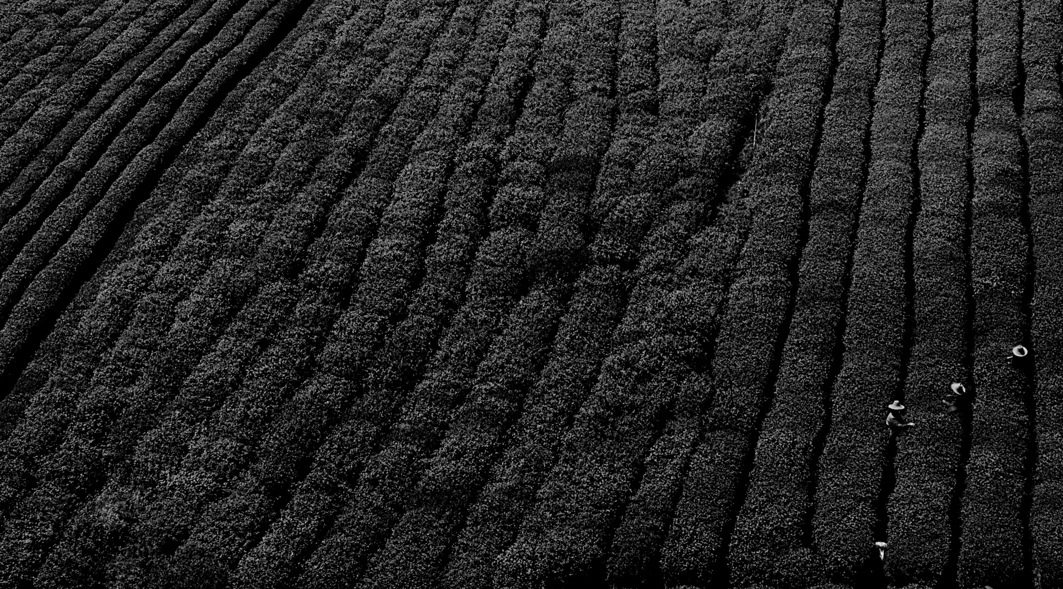
AGROBOT
Team Name: Decision Tree

Slide 2

PROBLEM STATEMENT
Agriculture bots which helps farmers to find
more efficient ways to protect their crops from weeds

Slide 3
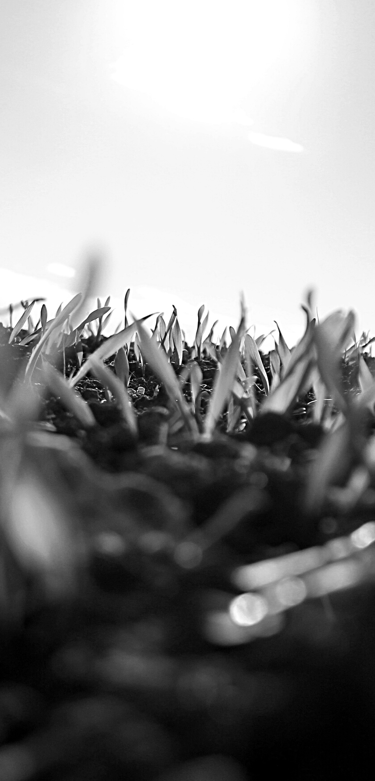
Our Product
Conversational bot to help farmers to find solutions to eradicate the weeds.
The bot provides FAQ's about weed control.
The bot works for all the languages - (user friendly)

Slide 4

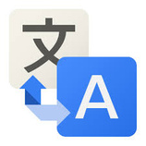









Architecture
Tokenization
Stemming
Stopwords
Translate to english
t
s
s
User
Tfidfvectorizer()
Data
Pre-processing
Inference
Data
types of weeds available
weed
solutions
FAQ's
Bot
Actions
Translate to user language
Inference Function
Cosine Similarity

Slide 5
Challenges Faced
Conversation with the chatbot was initially instructive due to issues with ontology matching.
Getting a dialog dataset to aid with detecting the similarity between test data and inference data

Slide 6

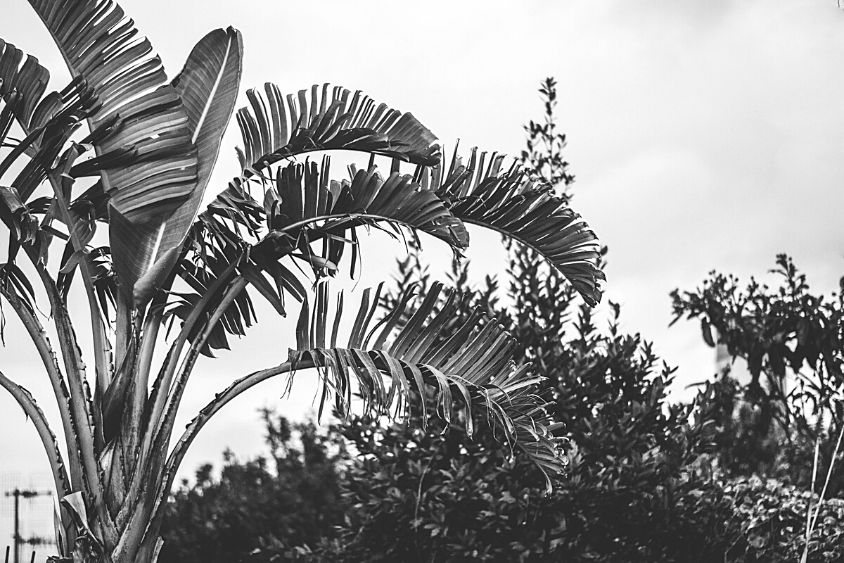
Potential features
A standalone web application/Mobile app
Implementing Image Recognition
Implementing Speech Recognition
Incorporating weed ontologies to get wide range of information.

Slide 7
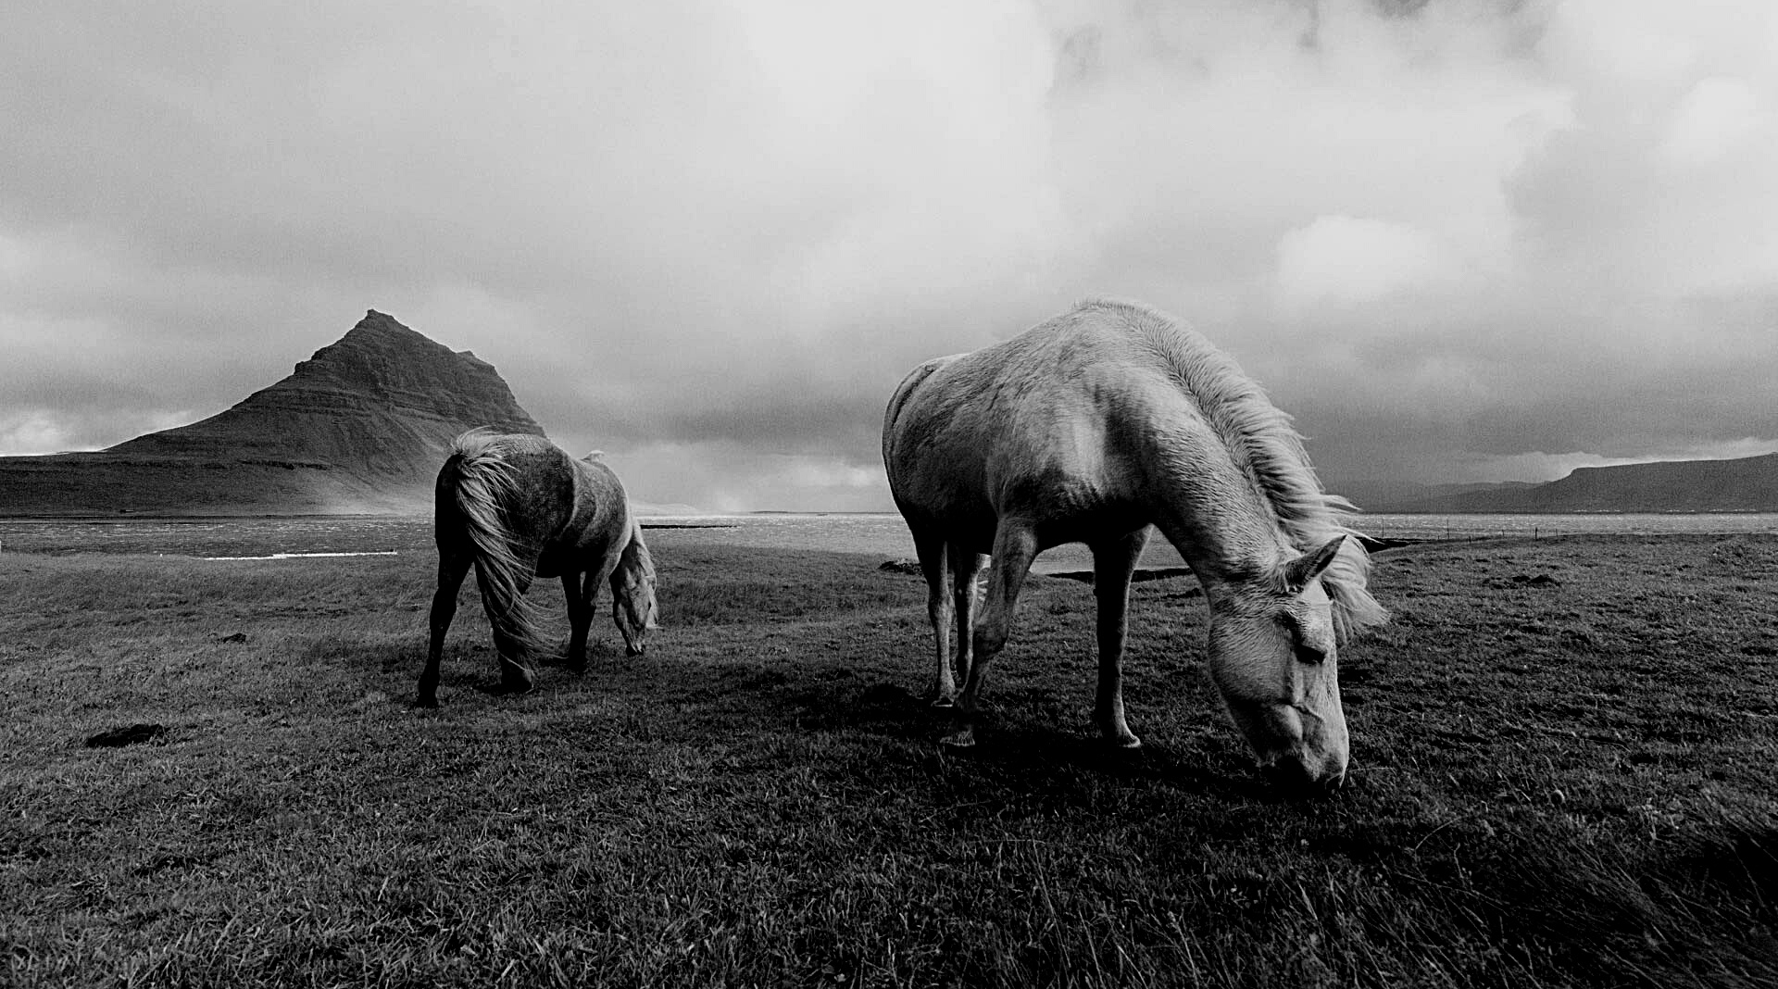

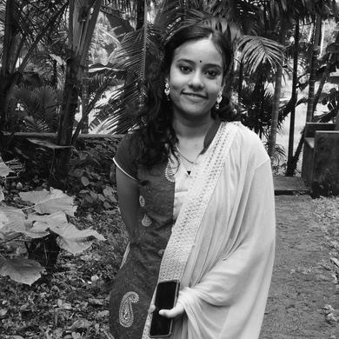
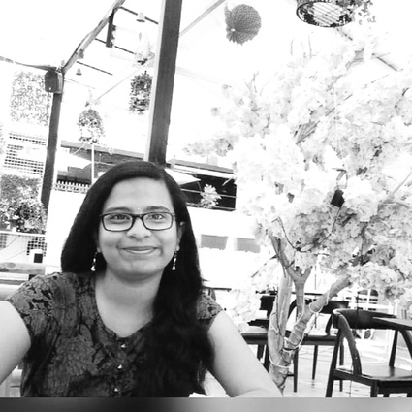
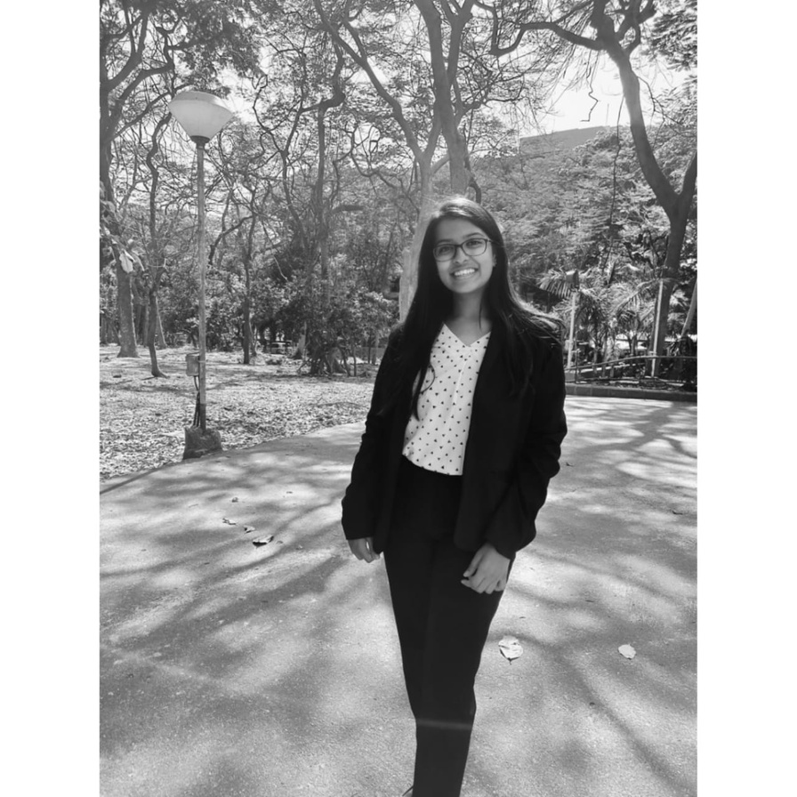
Team Members
Nithya
Varna
Akhila
Vaishnavi
From New Horizon College of Engineering Bangalore

Slide 8
TEAM DECISION TREE
Thank you!
"Build a team so strong that you don't know who the boss is"

